Slide 1
Machine learning:
prediction,
classification and
clustering
UBB Faculty of Sociology

Slide 2
Course Agenda
#1 Intro, Simple Linear Regression
#2 Python recap, Git, Handling data, EDA
#3 Regression, Decision Trees
#4 Bias, Variance, Overfitting, Classification, Metrics
#5 Random Forest Classifier, Clustering
#6 Neural Newtorks
#7 Help Final Project
#8 Help Final Project

Slide 3
5. Random Forest, Clustering
#5.1 Catch Up
#5.2 Decision Trees recap #5.3 Random Forests
#5.4 Clustering, k-means
#5.5 Final Project Task 4: Census Data Clustering - Optional
#5.6 Questions & Further reading

Slide 4

5.1 Catch up
Share one thing that stood out to you:
one thing you found surprising / interesting / useful etc.

Slide 5
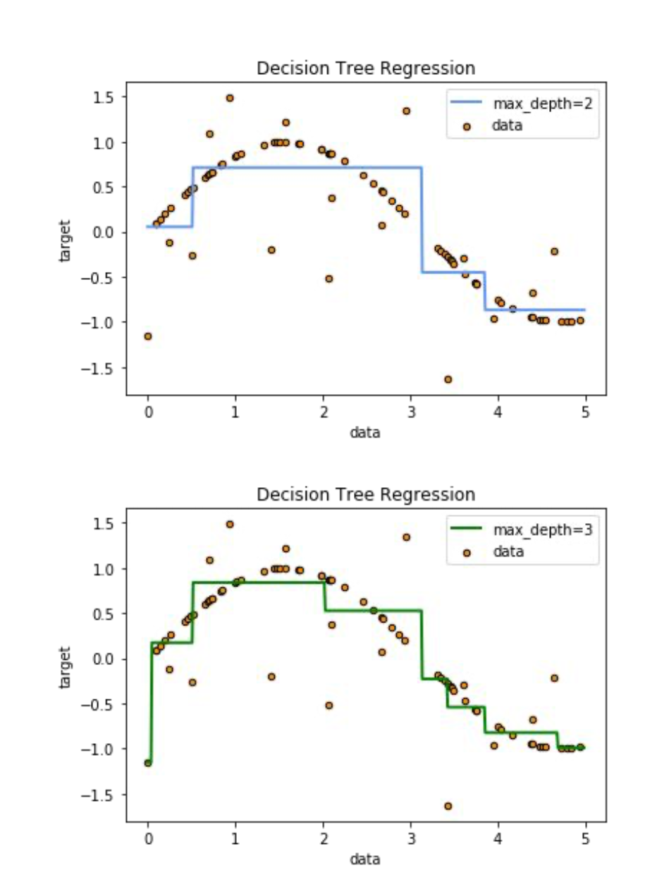
5.2 Decision Tree Recap
Decision Tree Regression
How it works: A two step repeating process
At each node, evaluate all possible splits of the dataset based on every feature.
Choose the split that minimizes the regression error metric MSE.
Then, repeat for the newly created subtrees

Slide 6
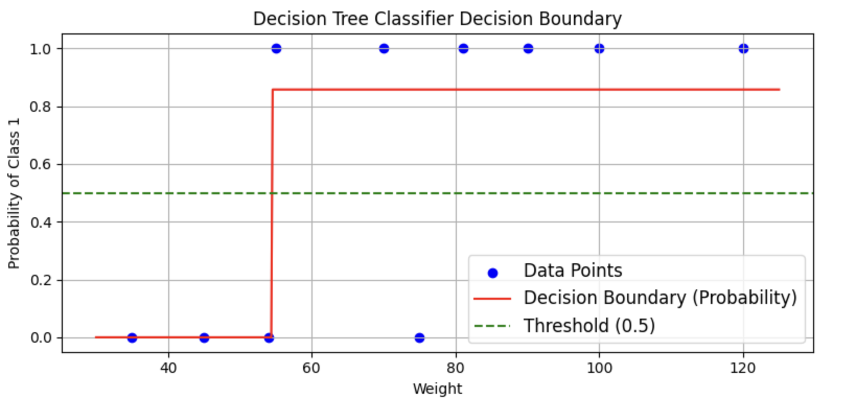
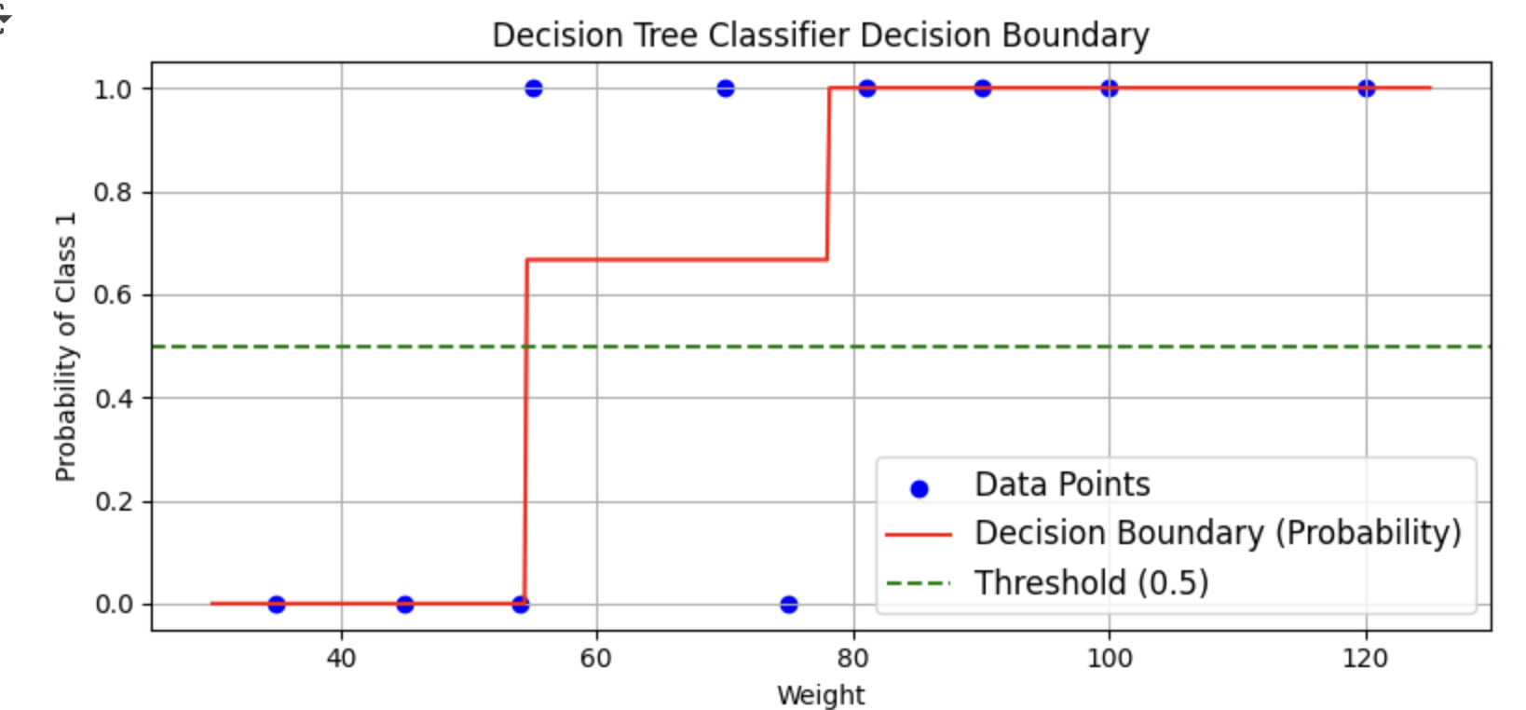
Decision Tree Classification
How it works: A two step repeating process
At each node, evaluate all possible splits of the dataset based on every feature.
Choose the split that minimizes the classification error metric Gini impurity
Then, repeat for the newly created subtrees

Slide 7
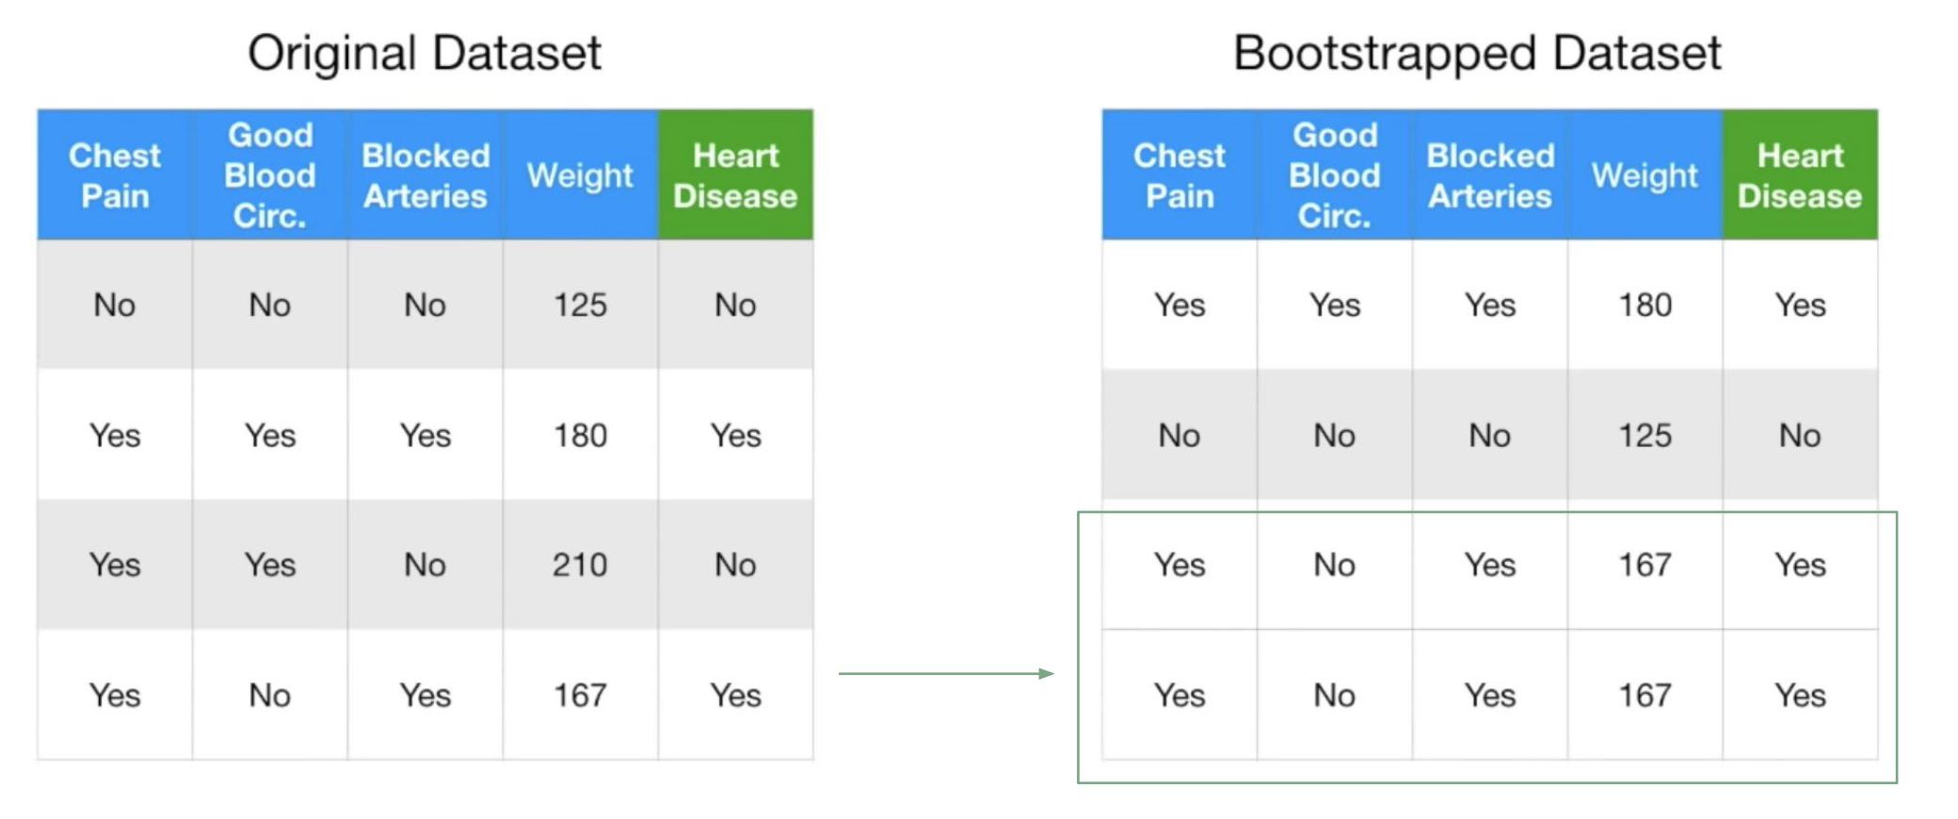
5.3 Random Forests
Are build from decision trees.
Step 1. Create a ‘bootstrapped’ dataset. Randomly select samples, with replacement.

Slide 8
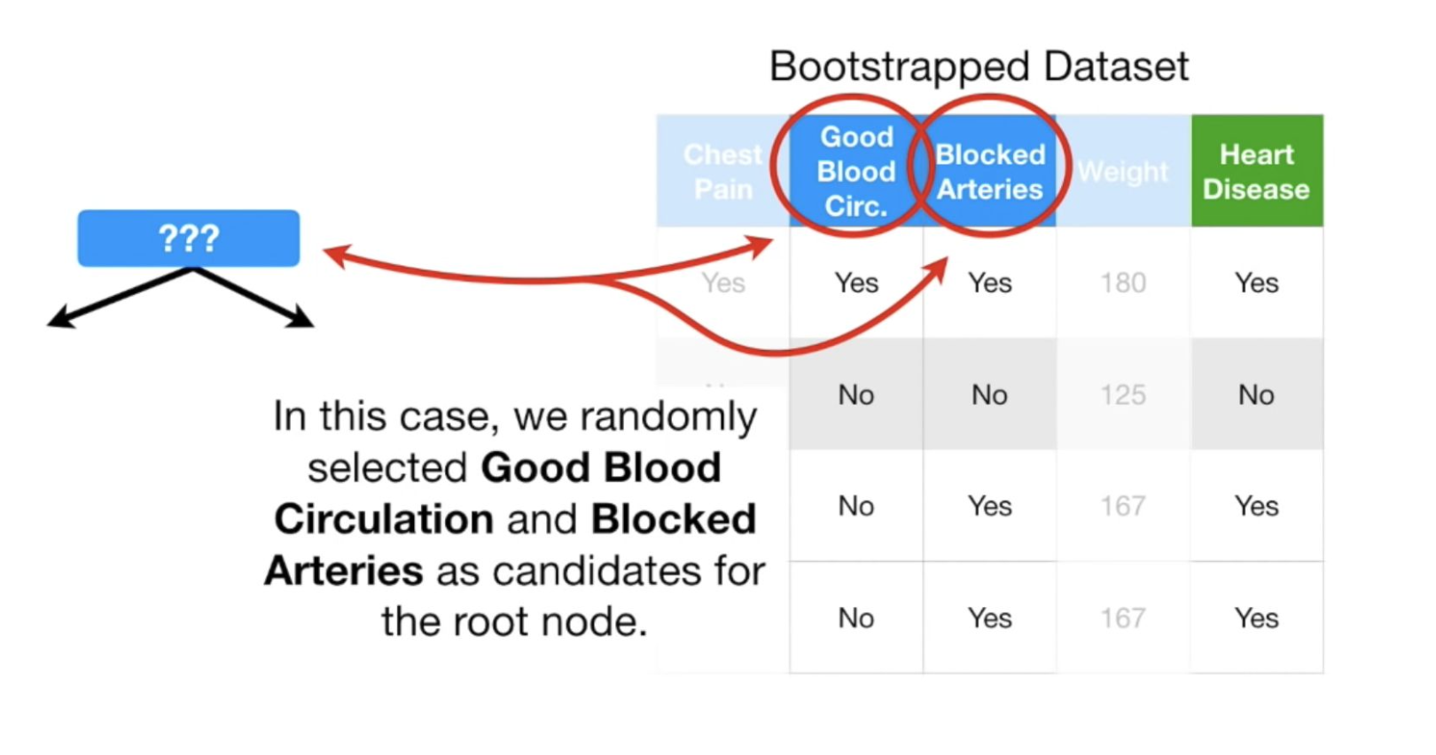
Step 2. Create a decision tree using a bootstaped dataset, but only use a
random subset of variables (or columns) at each step.

Slide 9
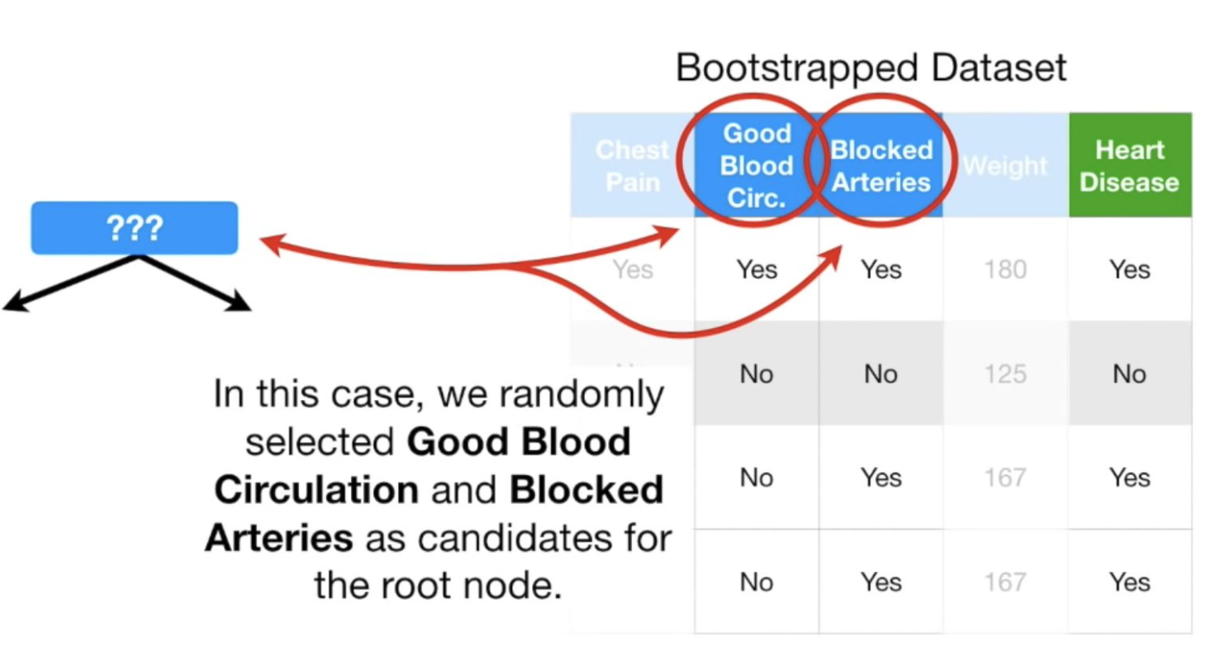
We find which variable out of two does the best job of separating the samples.

Slide 10
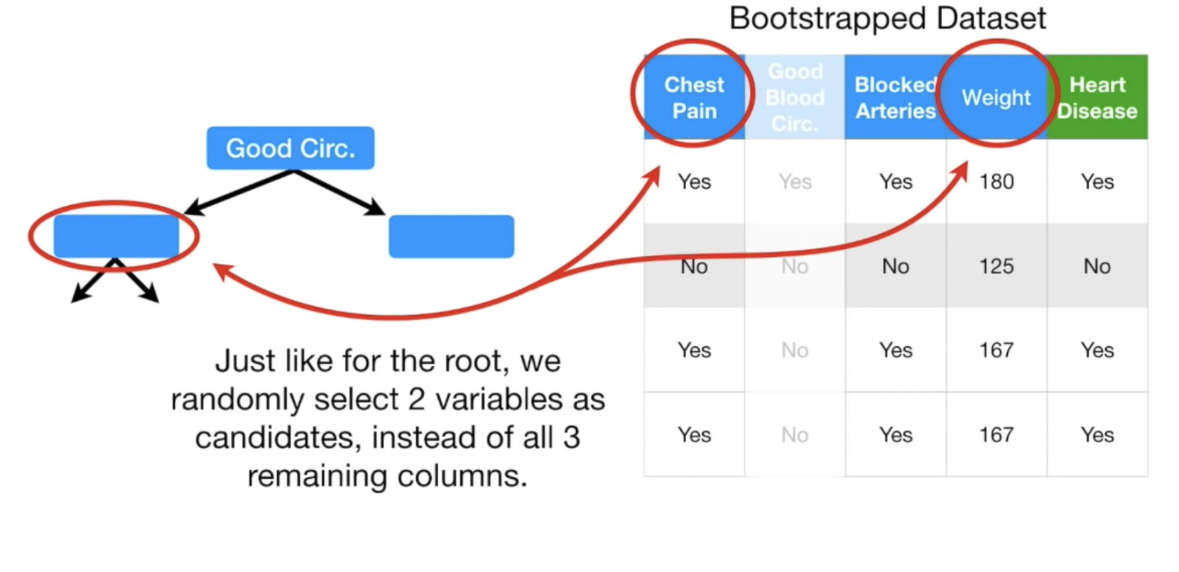
Let’s assume that is ‘Good Blood Circulation’. Now we have to figure out which
variable to use food the next node. We choose other 2 variables and find out
which one is the best at separating the samples.

Slide 11
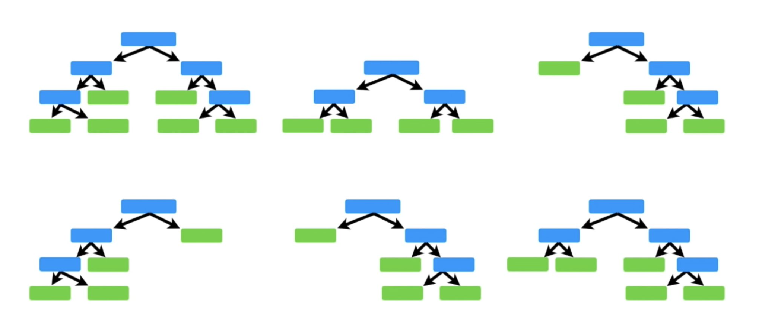
Go back to step 1 and repeat.
Create a decision tree using a bootstaped dataset, but only use a random subset of variables (or columns) at each step.

Slide 12
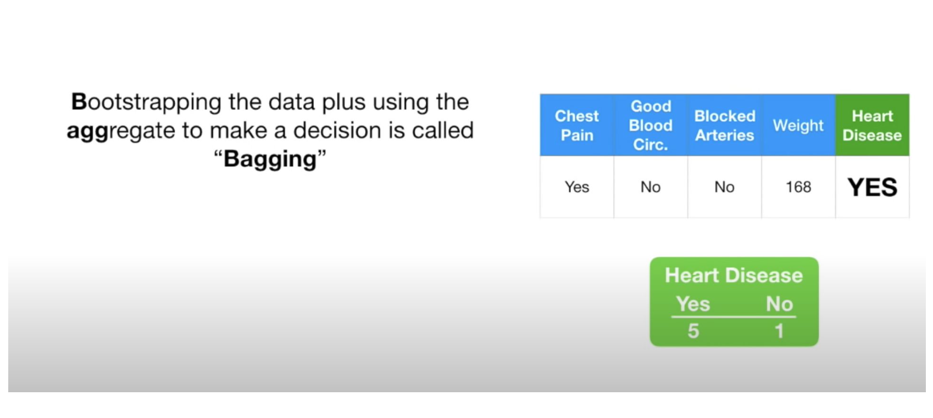

Slide 13
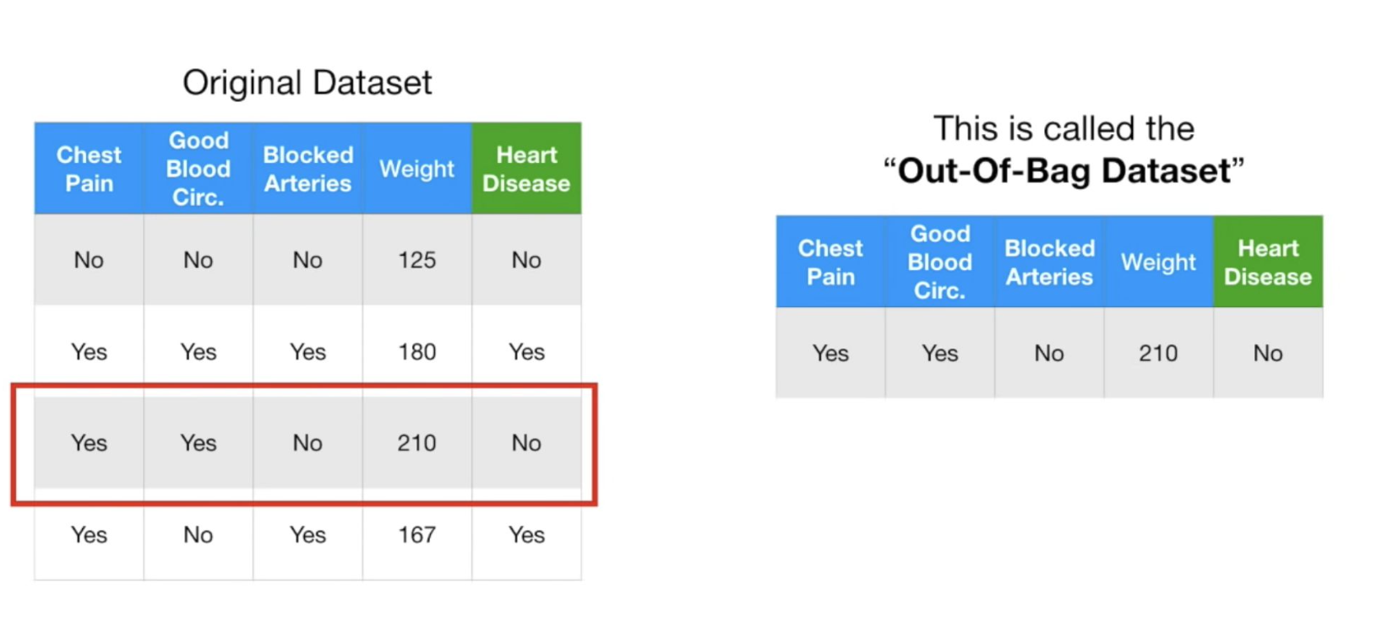
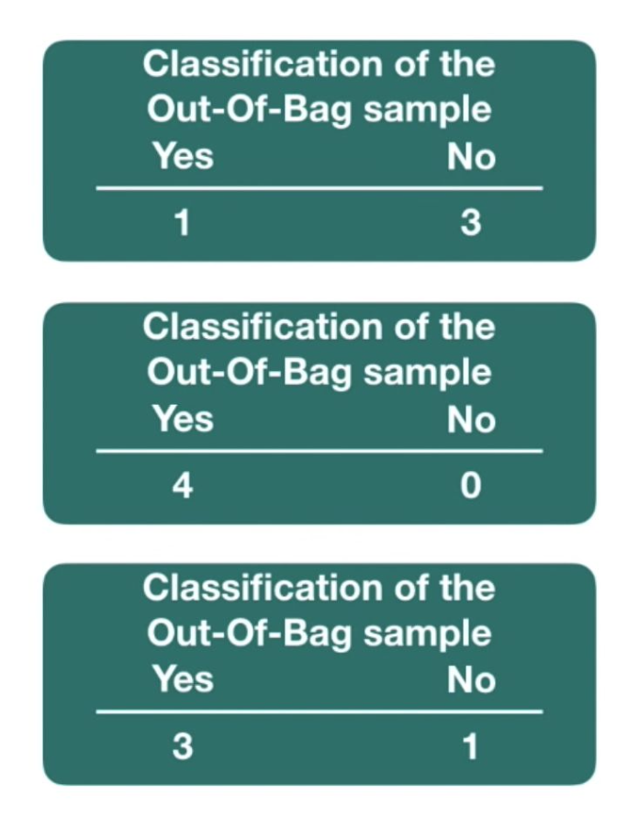
1. Evaluate on evaluation set.
2. Evaluate on OOB:
Estimate the accuracy of a random forest by evaluating Out-Of-Bag data on the trees that it was not used when created.

Slide 14
Random Forest:
Each tree - bootstrapped sampling (random with replacement)
Each node - random features ( 2 or more)
Split: Gini impurity, Entropy
Aggregates the result of trees, voting mechanism
Bagging: bootstrapped + aggregate

Slide 15
Pros:
High Accuracy: Combines multiple trees to reduce overfitting and improve prediction accuracy. Handles Missing Data: Can manage missing values and works with both categorical and numerical data.
Feature Importance: Provides insights into which features significantly impact predictions.
Resilient to Overfitting: The combination of multiple trees reduces the risk of overfitting, especially if hyperparameters are tuned properly.
Cons:
Complexity: Difficult to interpret compared to single decision trees.
Computationally Intensive, high memory usage: Training and prediction can be slow, especially with large datasets.
Bias in Feature Importance: Can overestimate the importance of numerical or high-cardinality features.

Slide 16
5.4 Feature Permutation
Permutation Feature Importance
Measures the increase in prediction error after permuting the feature.
Feature is important if:
Shuffling its value increases model error.
Feature is not important if:
Shuffling its value leaves error unchanged.

Slide 17
Permutation Feature Importance
Steps:
Estimate the original error.
For each feature:
- Permute the feature values in the data to break its association with the true
outcome
● Estimate error based on the prediction of the permuted feature,
● Calculate permutation feature importance,
● Sort features by descending feature importance.

Slide 18
5.5 Clustering, k-means
Unsupervised Learning
The data have no target attribute.
○ We want to explore the data to find some intrinsic structures in them.
In real life, most of the data relates to each other in ways we don’t know about.

Slide 19
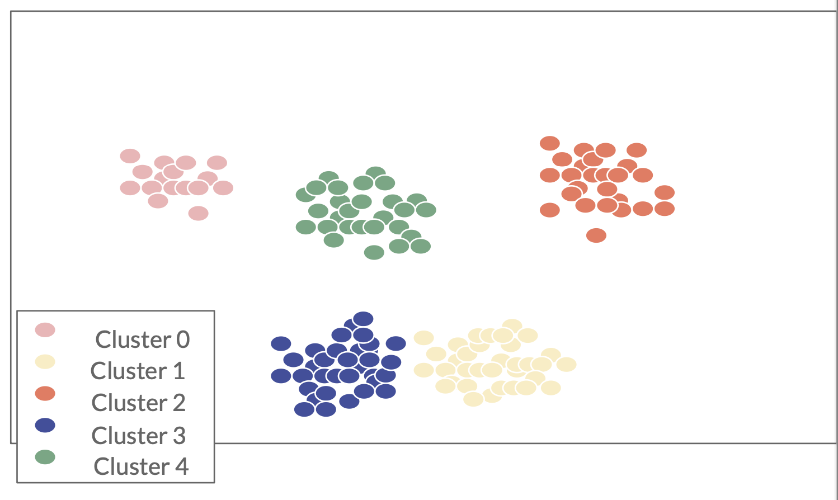
K-means
Unlabelled data: letting the ML find patterns for you
training set:
attributes-features-predictors
NO class (target feature).
output: find groups of cases with
nr of clusters:
-deciding before-hand (difficult decision) -More groups -> better fit, is it better?

Slide 20

Distance: Media consumption
Suppose we record the number of hours each user watched each channel. Cluster viewers by media consumption.

Slide 21
Use cases:
Understand audience segmentation for better marketing strategies.
Identify underperforming or highly popular channels among specific groups.
Predict future viewing patterns based on cluster behavior.

Slide 22
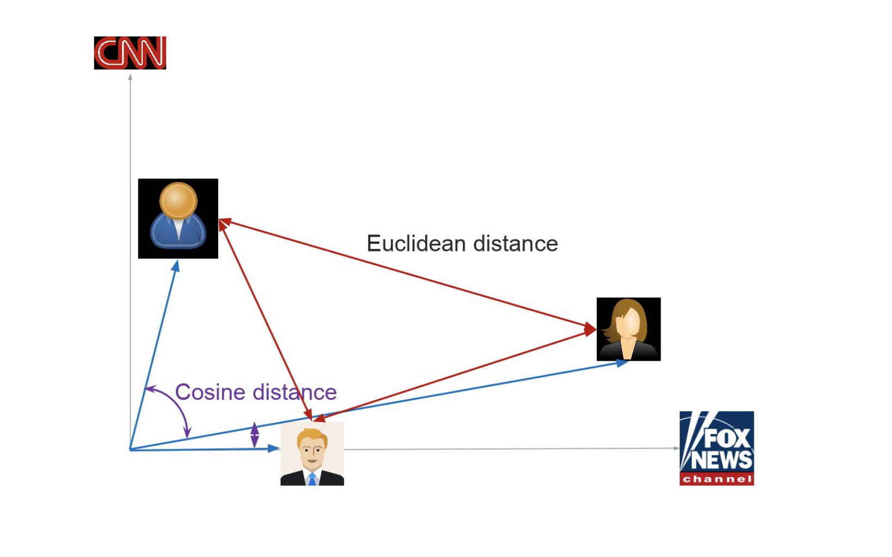
Only focus on 2 channels:

Slide 23
K-means steps:
Choose the Number of Clusters (k):
Decide how many groups (k) you want to divide your data into.
Initialize Centroids:
Randomly select k centroids (points representing the center of each cluster.
Assign Data Points to Nearest Centroid:
For each data point, calculate its distance to each centroid.
Assign the data point to the cluster of the closest centroid.
Update Centroids:
Recalculate the position of each centroid by taking the mean of all data points assigned to that cluster.
Repeat:
Reassign data points to the nearest centroids based on the updated centroids.
Recalculate centroids for the new clusters.
Stop When Converged:
The algorithm stops when the centroids no longer change significantly or the maximum number of iterations is reached.
Code on Colab

Slide 24
Intra-Cluster Distance (Compactness):
Measure how close the points within each cluster are to their cluster centroid.
Use metrics like Sum of Squared Distances (SSD) to ensure points are tightly packed within clusters. Lower values indicate better clustering.
Inter-Cluster Distance (Separation):
Measure how far apart the centroids of different clusters are.
Greater distances between centroids mean clusters are well-separated and distinct.
Silhouette Score: measures both Compactness and Separation: how well data points fit within their clusters and how distinct the clusters are from each other.
Elbow method: method for finding the optimal K value in a k-means clustering algorithm

Slide 25
5.6 Final Project Task 4: Census Data Clustering - Optional

Slide 26
5.5 Further Reading & Questions
#1 Random Forests: https://www.youtube.com/watch?v=J4Wdy0Wc_xQ
#2 Random Forests for missing data imputation and clustering: https://www.youtube.com/watch?v=sQ870aTKqiM
#3 K-means clustering: https://www.youtube.com/watch?v=4b5d3muPQmA #3 Feature Permutation Importance: https://www.youtube.com/watch?v=VUvShOEFdQo #4 Anomaly detection example: https://www.datarobot.com/use-cases/credit-card-fraudulent-transactions/

Slide 27
Thank you !!
Machine Learning Engineer / Data Scientist
zahariesergiu@gmail.com
https://www.linkedin.com/in/zahariesergiu/
https://github.com/zahariesergiu/ubb-sociology-ml

